Slide 1

SMART INDIA HACKATHON 2026
TITLE PAGE
Problem Statement ID –
Problem Statement Title-
college bus tracking system
Theme- transportation and logistics
PS Category- Software
Team ID-
Team Name : Runtime Rebels

Slide 2
Runtime Rebel
IDEA TITLE
Problems Students Face
PROPOSED SOLUTION
• No live bus location
• Unnecessary waiting at stops
• No clear arrival / delay information
• Difficulty monitoring buses
A GPS-based system that shows the bus's current location and estimated arrival time to students.
WHY IT IS DIFFERENT
Live location
Less waiting
Simple interface
Future SOS alerts
[YOUR TEAM NAME]
SMART INDIA HACKATHON 2025

Slide 3
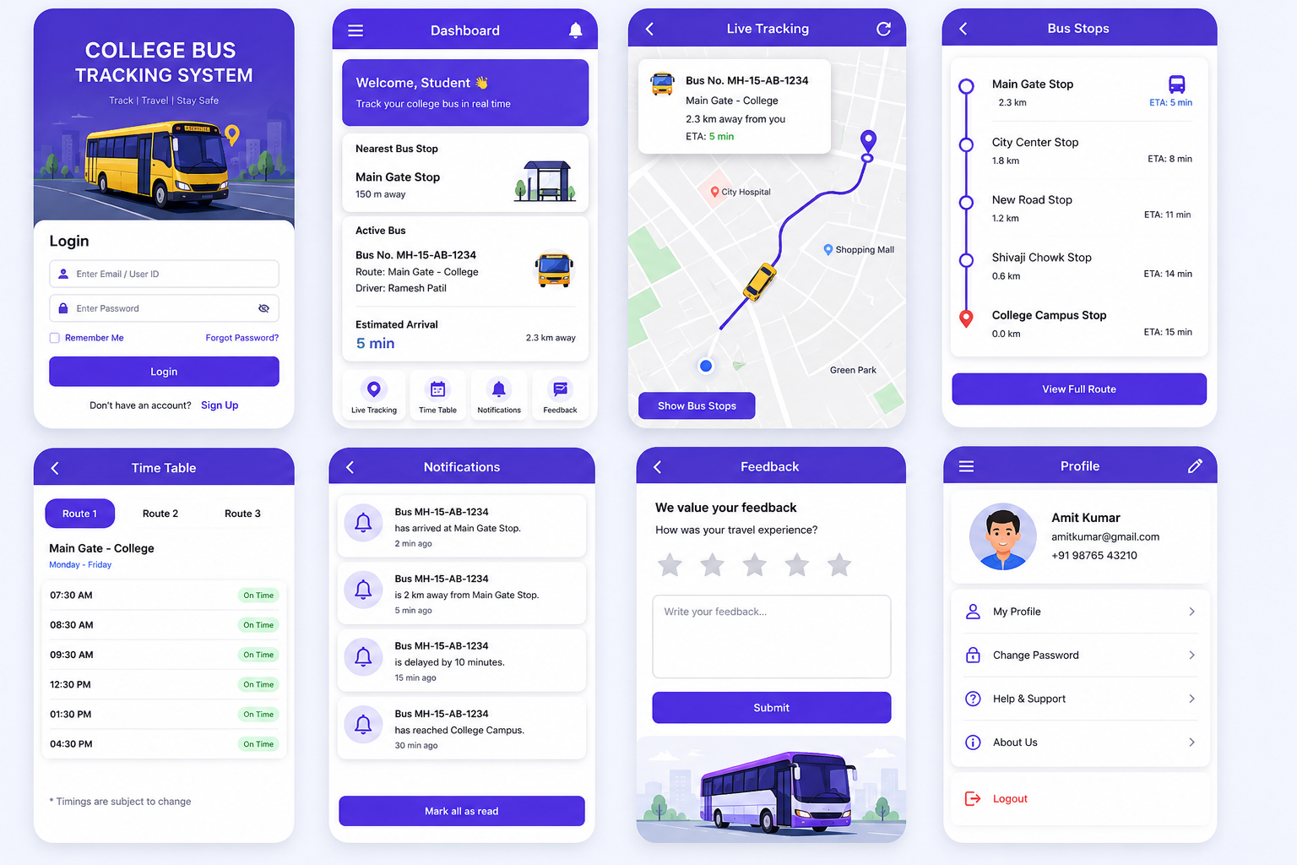
Runtime Rebel
TECHNICAL APPROACH
Technology
• C / C++
• MySQL
• GPS / location service
• Map + app interface
SYSTEM FLOW
BUS
→
GPS
→
SERVER
→
APP
→
STUDENT
[YOUR TEAM NAME]
SMART INDIA HACKATHON 2025

Slide 4
Runtime
rebels
FEASIBILITY & VIABILITY
Feasible Because
Key Risks
Mitigation
easy availability of GPS and mobile netwrok
minimal hardware required
• Internet connectivity
• GPS accuracy
• Data privacy
• Keep last known location
• Use reliable GPS
• Secure user data
[YOUR TEAM NAME]
SMART INDIA HACKATHON 2025

Slide 5
Runtime Rebels
IMPACT & BENEFITS
TIME
SAFETY
Real-time bus location.
less waiting at stops.
better journey visibilty
parent awareness
CONTROL
CONVENIENCE
delay identification
better route planing
Simple live tracking
arrival notifications
Target users: Students • Parents • Drivers • College Administration
[YOUR TEAM NAME]
SMART INDIA HACKATHON 2025

Slide 6
Runtime Rebelss
RESEARCH & REFERENCES
Research Areas
References Used
• GPS-based vehicle tracking
• College transport systems
• C / C++ programming concepts
• MySQL database concepts
• Digital maps and location services
• Classroom / lab learning resources
• GPS and database documentation
• Nashik city bus app
• SIH Idea Presentation Template
[YOUR TEAM NAME]
SMART INDIA HACKATHON 2025

